Slide 1
Syntactic Parsing And CKY Parser
CS 162: Natural Language Processing
Nanyun (Violet) Peng
Course website: https://vnpeng.net/cs162_win24.html
syllabus,
announcements,
slides,
homeworks
based on slides of Jason Eisner
1

Slide 2
Important Announcements
Assignment 3 dues next Monday!
Review topics for the final
  Will setup a survey on Piazza. Due this Sunday!
  Both the TAs and me will try to review selected topics.
The course evaluation is open.
  We want to hear from you (as always)!
  As our tradition, I will offer +3% bonus to everyone for the final exam if more than 80% of the class submit the course evaluation. ☺
  Close on 8:00 AM Saturday, March 16

Slide 3
Syntax
“Hexy planars garumphed by the snox three zamfirs ago.”
  What kind of planars are being discussed?
  Is there a main verb in this sentence? If yes, which one?
  Is there a mention for when?
  Why do you know that?

Slide 4
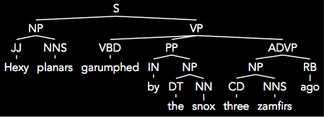
Syntax
The characteristics of the words and their relations to each other allow us to generate this interpretation even though we don’t really understand the semantics of each word.
The goal of parsing is to write a computer program to generate this automatically.

Slide 5
What is Parsing?
S → NP VP
NP → Det N
NP → NP PP
VP → V NP
VP → VP PP
PP → P NP
NP → Papa
N → caviar
N → spoon
V → spoon
V → ate
P → with
Det → the
Det → a
S
NP
VP
VP
PP
V
NP
P
NP
Det
N
Det
N
Papa
ate
the
caviar
with
a
spoon

Slide 6
Programming languages
def viterbi_algorithm(observations, states, start_p, trans_p, emit_p):
V = [{}]
for st in states:
V[0][st] = {"prob": start_p[st] * emit_p[st][observations[0]], "prev": None}
for t in range(1, len(observations)):
V.append({})
for st in states:
max_tr_prob = V[t - 1][states[0]]["prob"] * trans_p[states[0]][st]
prev_st_selected = states[0]
for prev_st in states[1:]:
tr_prob = V[t - 1][prev_st]["prob"] * trans_p[prev_st][st]
if tr_prob > max_tr_prob:
max_tr_prob = tr_prob
prev_st_selected = prev_st
max_prob = max_tr_prob * emit_p[st][observations[t]]
V[t][st] = {"prob": max_prob, "prev": prev_st_selected}
for line in dptable(V):
print(line)
Easy to parse.
Designed that way!
Notes:
Let me start with a few words on parsing.
This is random code from Emacs, so if you see anything you like, it’s yours.
It’s written in an artificial language, designed to be easy to parse. Not completely trivial - we can’t tell whether (re_opcode_t) * (p-1) is a pointer cast or a mulitiplication, without some more context. But the scope of the ifs and fors is clearly marked. So is order of operations.

Slide 7
Natural languages
def viterbi_algorithm(observations, states, start_p, trans_p, emit_p):V = [{}] for st in states: V[0][st] = {"prob": start_p[st] * emit_p[st][observations[0]], "prev": None} for t in range(1, len(observations)): V.append({}) for st in states: max_tr_prob = V[t - 1][states[0]]["prob"] * trans_p[states[0]][st] prev_st_selected = states[0] for prev_st in states[1:]: tr_prob = V[t - 1][prev_st]["prob"] * trans_p[prev_st][st] if tr_prob > max_tr_prob: max_tr_prob = tr_prob prev_st_selected = prev_st max_prob = max_tr_prob * emit_p[st][observations[t]] V[t][st] = {"prob": max_prob, "prev": prev_st_selected} for line in dptable(V): print(line)
No indentation to indicate scope & precedence
Lots of overloading (ambiguity!)
Grammar isn’t known in advance!
Context-free grammar not best formalism
Notes:
To get some flavor for why natural language is harder , think about parsing
this. Same code, but now we have no parentheses or indentation. Without that information, this is wildly ambiguous.
There are many other reasons why natural languages are subtle and difficult, but maybe the biggest - and most important for today - is function overloading. The English verb “bet”, B-E-T, can be either a noun or a verb, and as a verb it can take from 1 to 4 arguments: “I, would bet, you, five dollars, that it’s got four arguments.” But you can also say “you bet!”
Finally, you didn’t design the language, so you don’t know the grammar in advance. In fact, there’s a long-standing question as to what class of grammars is even appropriate for natural languages.

Slide 8
Ambiguity
S → NP VP
NP → Det N
NP → NP PP
VP → V NP
VP → VP PP
PP → P NP
S
NP → Papa
N → caviar
N → spoon
V → spoon
V → ate
P → with
Det → the
Det → a
NP
VP
Papa
VP
PP
V
NP
P
NP
ate
Det
N
with
Det
N
the
caviar
a
spoon

Slide 9
Ambiguity
S → NP VP
NP → Det N
NP → NP PP
VP → V NP
VP → VP PP
PP → P NP
S
NP → Papa
N → caviar
N → spoon
V → spoon
V → ate
P → with
Det → the
Det → a
NP
VP
Papa
V
NP
ate
NP
PP
Det
N
P
NP
the
caviar
with
Det
N
a
spoon

Slide 10
The parsing problem
correct test trees
P
A
R
S
E
R
s
c
o
r
e
r
accuracy
Recent parsers quite accurate
… good enough
to help a range of NLP tasks!
test
sentences
Grammar
Notes:
That’s why parsing is hard; here’s what a parser does. We feed it some sentences. For each sentence, it consults its grammar, and produces a tree whose leaves are the sentence’s words, and whose structure is intended to be helpful.
If you want to see how good the parser is, feed it some test sentences, and using your favorite scoring method, compare the output trees to an answer key of trees produced by a human. Suffice it to say that the recent crop of parsers is quite accurate. Most sentences are parsed correctly, or with one error

Slide 11
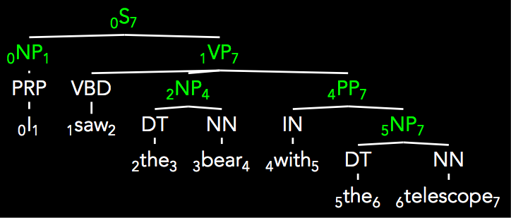
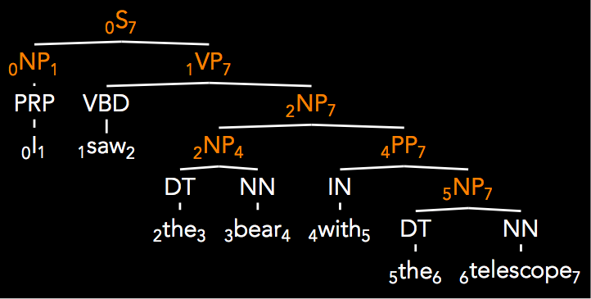
Parser Evaluation
Parseval (Black et al. ’91)
Decompose tree into labeled constituent spans
(note: POS tags not considered!)
Calculate balanced precision and recall (f-measure)
(S 0 7)
(NP 0 1)
(VP 1 7)
(NP 2 4)
(PP 4 7)
(NP 5 7)
(S 0 7)
(NP 0 1)
(VP 1 7)
(NP 2 7)
(NP 2 4)
(PP 4 7)
(NP 5 7)

Slide 12
Parser Evaluation
(S 0 7)
(NP 0 1)
(VP 1 7)
(NP 2 7)
(NP 2 4)
(PP 4 7)
(NP 5 7)
(S 0 7)
(NP 0 1)
(VP 1 7)
(NP 2 4)
(PP 4 7)
(NP 5 7)
A = answers
C = correct
Precision: Of the answers I gave, what percent were correct?
|A ⋂ C| / |A|
Recall: What percent of the correct answers did I give?
|A ⋂ C| / |C|
F1: Harmonic mean of Precision and Recall (reciprocal of mean of reciprocals)
2*P*R / P+R
2*|A ⋂ C| / (|C| + |A|)

Slide 13
Parser Evaluation
A = answers
C = correct
(S 0 7)
(NP 0 1)
(VP 1 7)
(NP 2 7)
(NP 2 4)
(PP 4 7)
(NP 5 7)
(S 0 7)
(NP 0 1)
(VP 1 7)
(NP 2 4)
(PP 4 7)
(NP 5 7)
extra!
|A ∩ C| = 6
|A| = 7
|C| =6
R = 1.0
P= .857
F1 = .923

Slide 14
Parsing
Now let’s develop some parsing algorithms!
How do we do that?
Notes:
Plans, raise, tax

Slide 15
“Papa ate the caviar with a spoon”
0
1
2
3
4
5
6
7
S → NP VP
NP → Det N
NP → NP PP
VP → V NP
VP → VP PP
PP → P NP
NP → Papa
N → caviar
N → spoon
V → spoon
V → ate
P → with
Det → the
Det → a

Slide 16
First try … does it work?
0
1
2
3
4
5
6
7
“Papa ate the caviar with a spoon”
for each constituent on the LIST (Y i mid)
  scan the LIST for an adjacent constituent (Z mid j)
  if grammar has a rule to combine them (X → Y Z)
    then add the result to the LIST (X i j)
Notes:
2 questions: how to define (initialize) the constituents? How to produce the whole tree? (this only works for 1 layer)

Slide 17
Second try …
0
1
2
3
4
5
6
7
“Papa ate the caviar with a spoon”
initialize the list with parts-of-speech (T j-1 j)
where T is a preterminal tag (like Noun) for the J^{th} word
for each constituent on the LIST (Y i mid)
  scan the LIST for an adjacent constituent (Z mid j)
  if grammar has a rule to combine them (X → Y Z)
    then add the result to the LIST (X i j)
if the above loop added anything, do it again!
(so that X i j gets a chance to combine or be combined with)
Notes:
Problem: cannot handle ambiguity (multiple valid parses); also efficiency issue.

Slide 18
Third Try…
0
1
2
3
4
5
6
7
“Papa ate the caviar with a spoon”
initialize the list with parts-of-speech (T j-1 j)
for each constituent on the LIST (Y i mid)
  for each adjacent constituent on the list (Z mid j)
    for each rule to combine them (X → Y Z)
      add the result to the LIST (X i j)
      if it’s not already there
if the above loop added anything, do it again!
(so that X i j gets a chance to combine or be combined with)
Notes:
Efficiency issue.

Slide 19
0
1
2
3
4
5
6
7
“Papa ate the caviar with a spoon”
Third Try…
Initialize
NP 0 1
V 1 2
Det 2 3
N 3 4
P 4 5
Det 5 6
N 6 7
V 6 7
1st pass
NP 2 4
NP 5 7
2nd pass
VP 1 4
NP 2 4
PP 4 7
NP 5 7
3rd pass
…

Slide 20
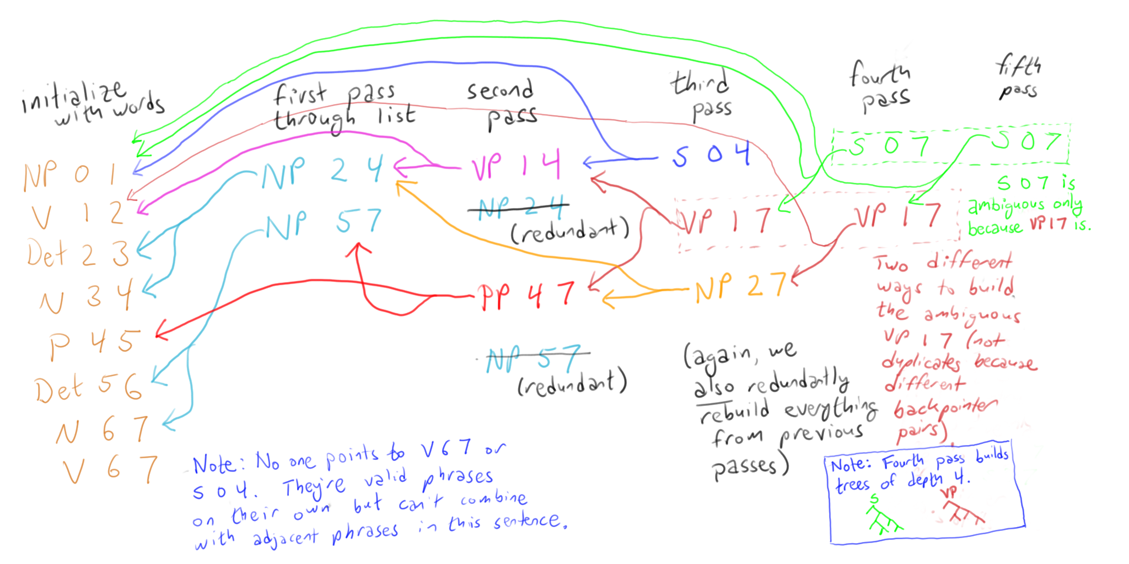
Follow backpointers to get the parse
0
1
2
3
4
5
6
7
“Papa ate the caviar with a spoon”

Slide 21
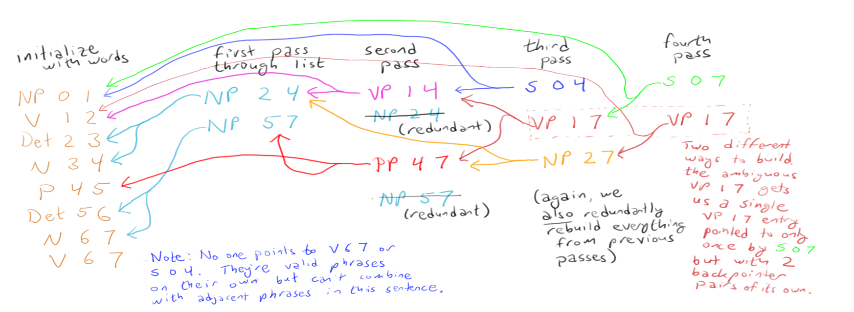
Turn sideways:
See the trees?
“Papa ate the caviar with a spoon”

Slide 22
Correct but inefficient …
We kept checking the same pairs that we’d checked before (both bad and good pairs)
    Can’t we manage the process in a way that avoids duplicate work?
And even finding new pairs was expensive because we had to scan the whole list
    Can’t we have some kind of index that will help us find adjacent pairs?

Slide 23
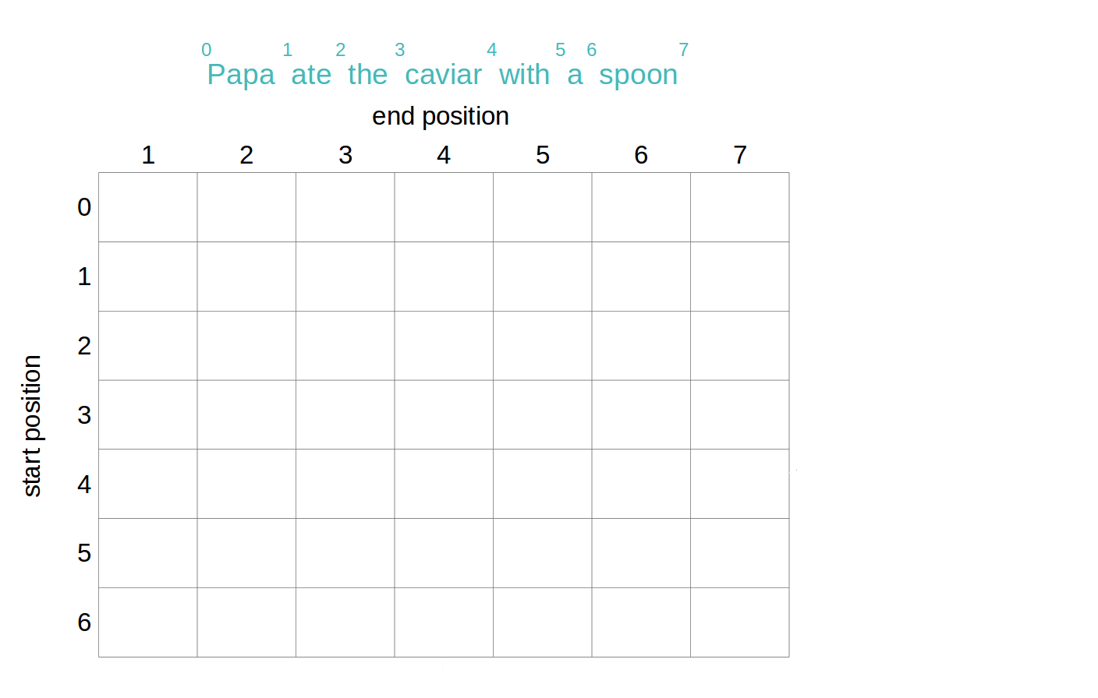
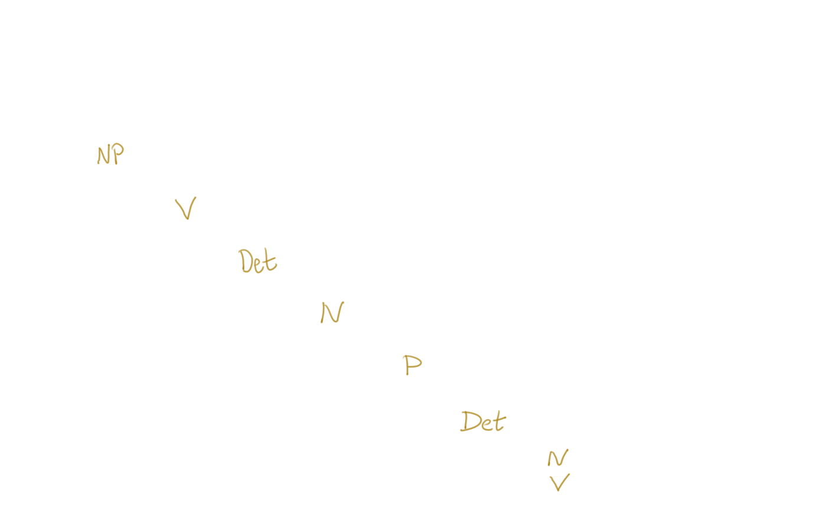
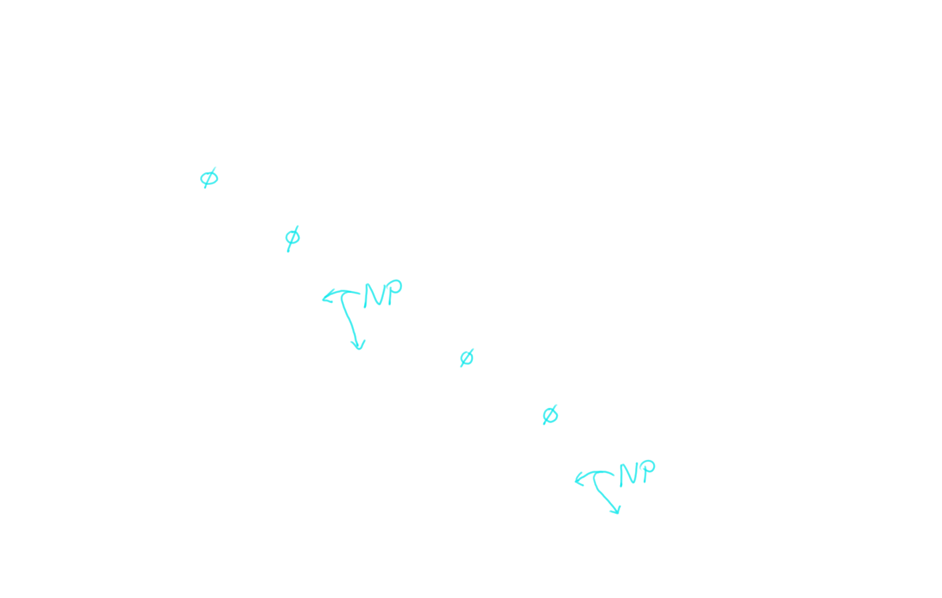
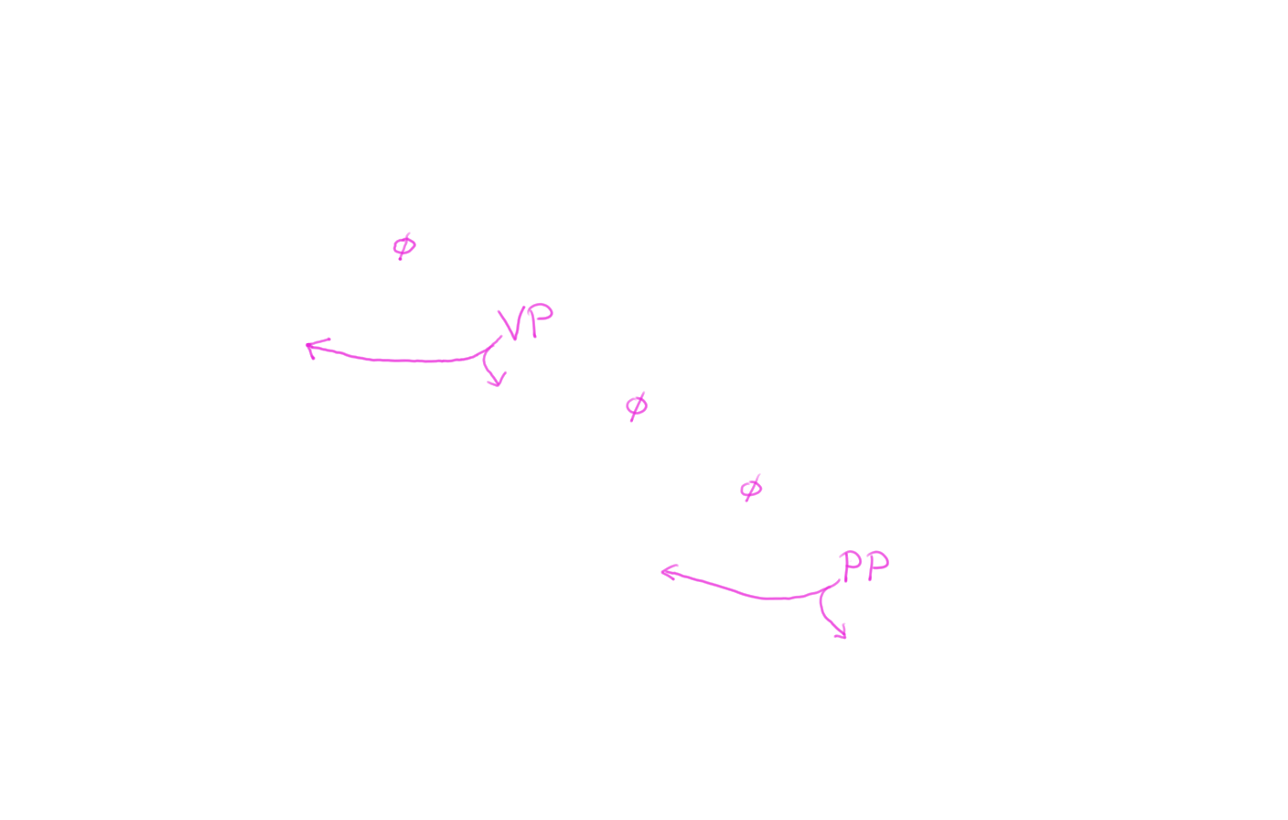
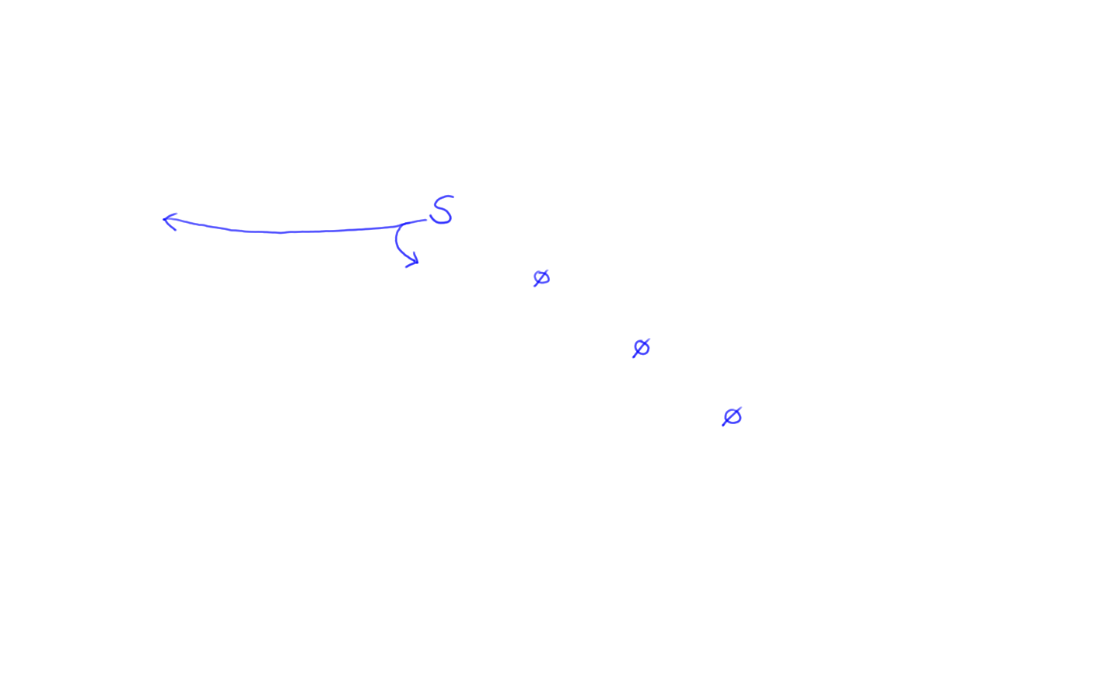
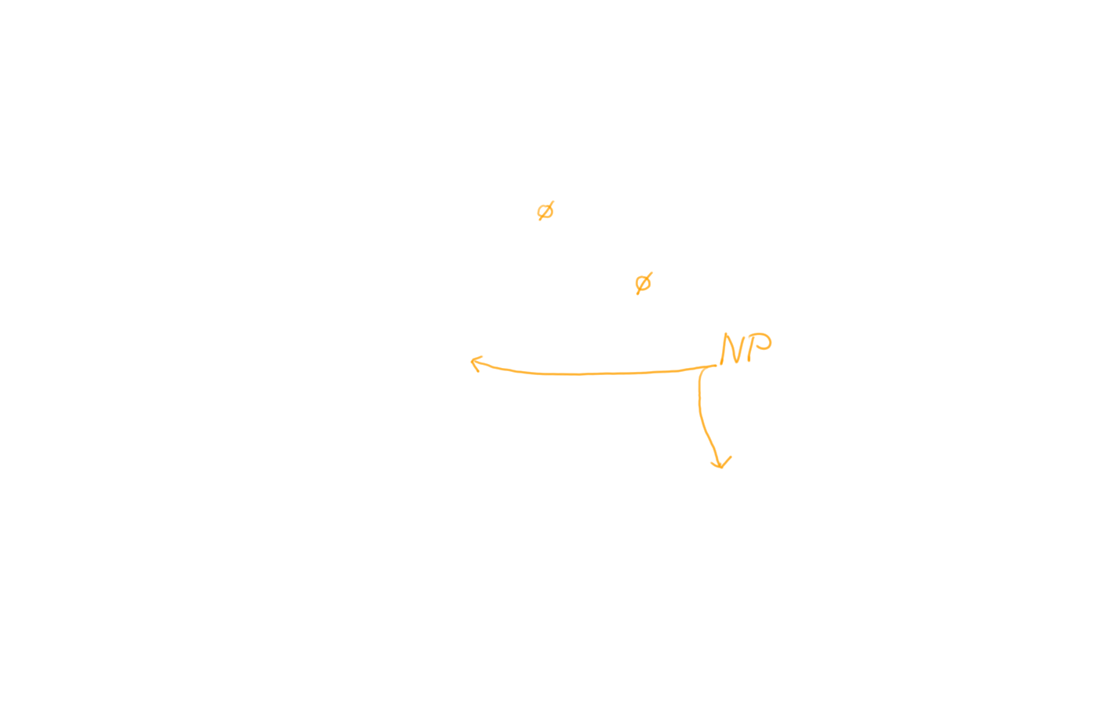
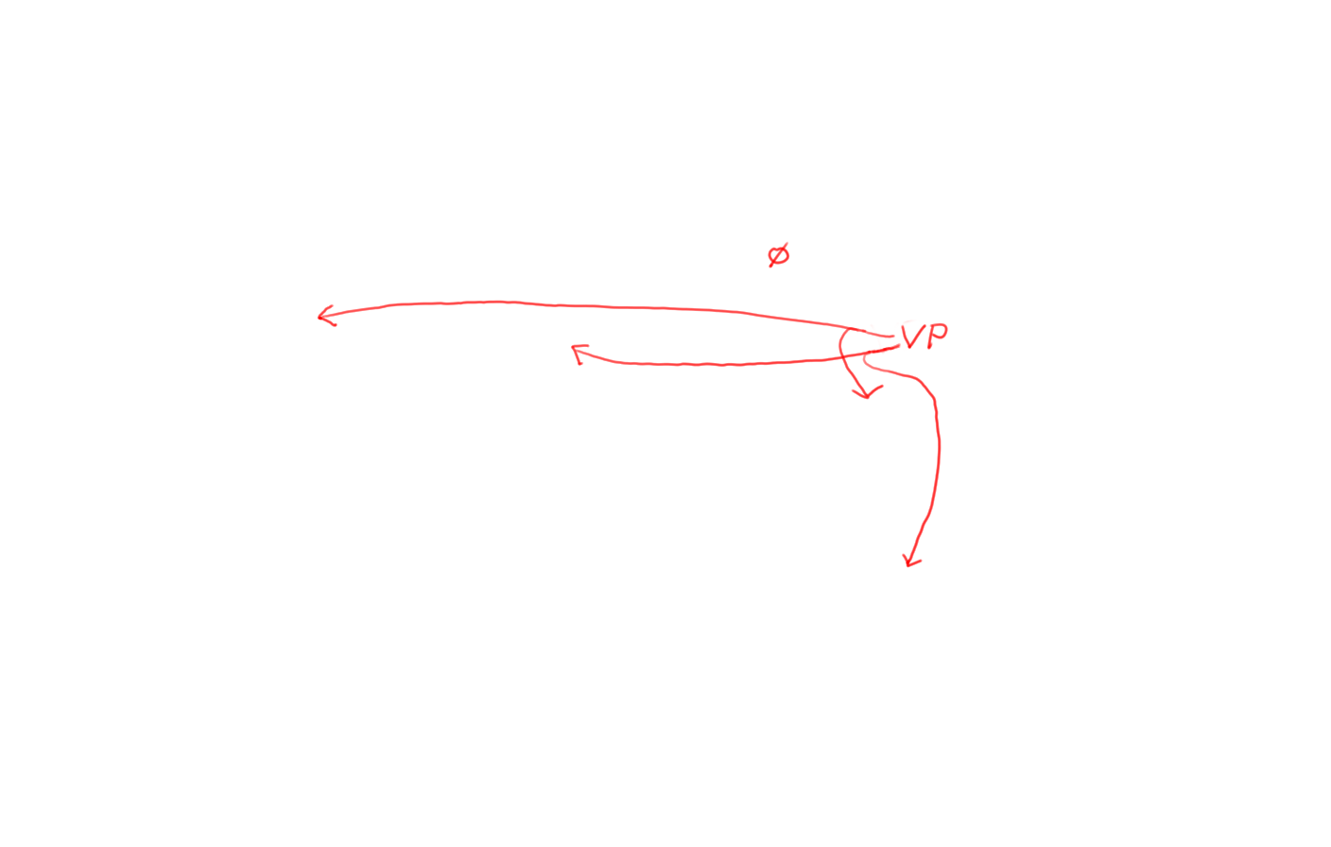
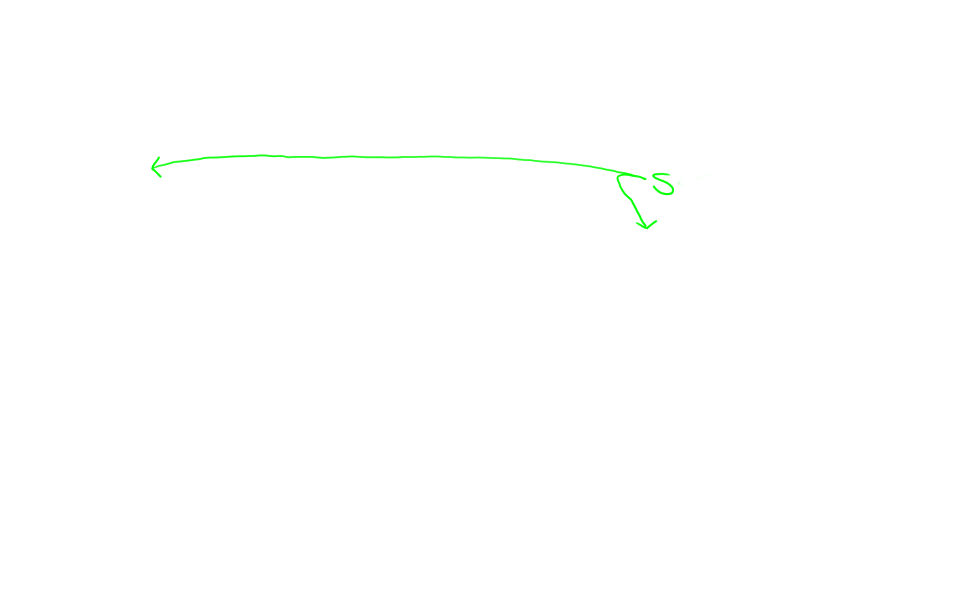
Indexing: Store S 0 4 in chart[0,4]

Slide 24
Avoid duplicate work:
Build width-1, then width-2, etc.

Slide 25
How do we build a width-6 phrase?
(after building and indexing all shorter phrases)
?
1 7 =
1 2 + 2 7 ☺
1 3 + 3 7
1 4 + 4 7 ☺
1 5 + 5 7
1 6 + 6 7

Slide 26
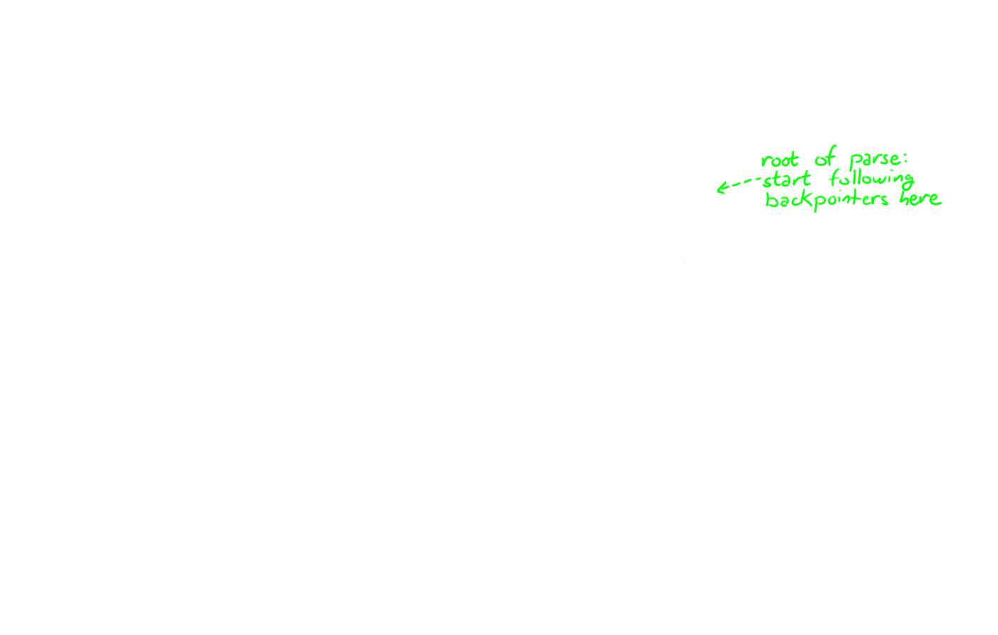
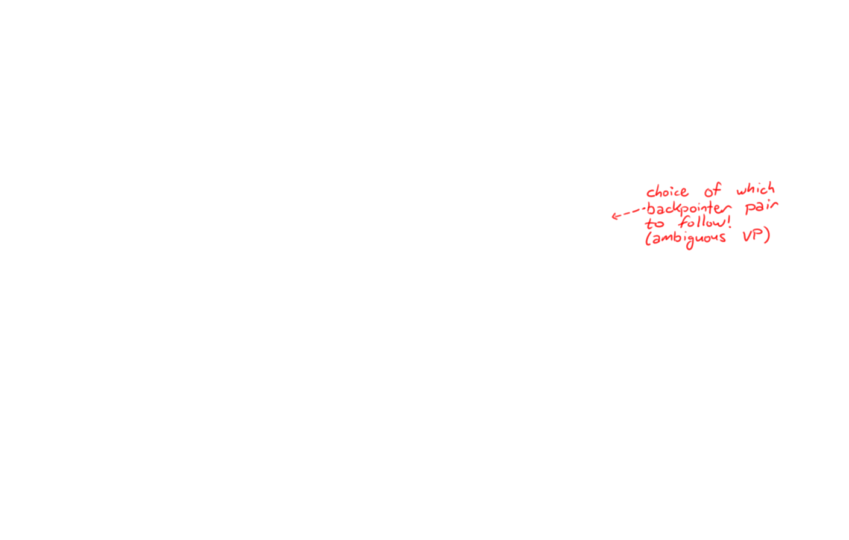
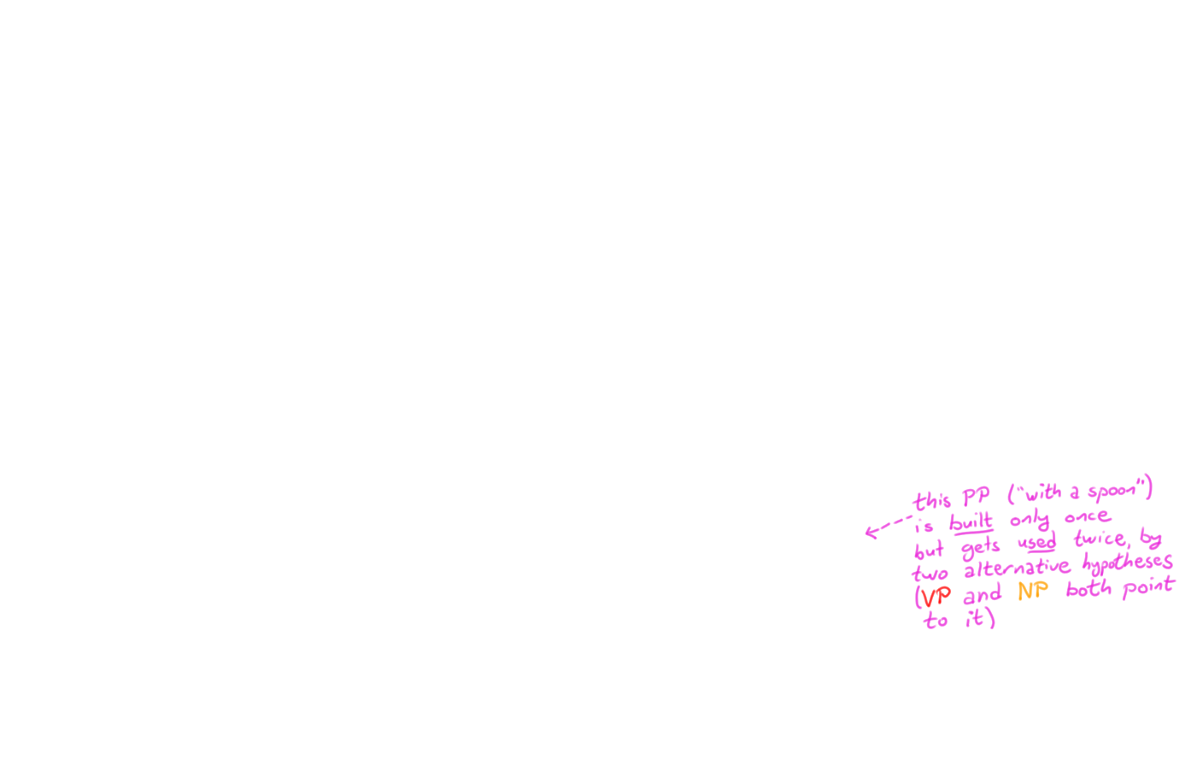
Avoid duplicate work:
Build width-1, then width-2, etc.

Slide 27
CKY algorithm, recognizer version
Input: string of n words
Output: yes/no (since it’s only a recognizer)
Data structure: n × n table
  rows labeled 0 to n-1
  columns labeled 1 to n
  cell [i,j] lists constituents found between i and j
Basic idea: fill in width-1 cells, then width-2, …

Slide 28

“Papa ate the caviar with a spoon”
1
2
3
4
5
6
7
0
[0,1]
[0,2]
[0,3]
[0,4]
[0,5]
[0,6]
[0,7]
1
[1,2]
[1,3]
[1,4]
[1,5]
[1,6]
[1,7]
S → NP VP
NP → Det N
NP → NP PP
VP → V NP
VP → VP PP
PP → P NP
NP → Papa
N → caviar
N → spoon
V → spoon
V → ate
P → with
Det → the
Det → a
2
[2,3]
[2,4]
[2,5]
[2,6]
[2,7]
Length 1
3
[3,4]
[3,5]
[3,6]
[3,7]
4
[4,5]
[4,6]
[4,7]
5
[5,6]
[5,7]
6
[6,7]
Notes:
Where are the lengh 1 cells/

Slide 29
“Papa ate the caviar with a spoon”
1
2
3
4
5
6
7
0
[0,1]
[0,2]
[0,3]
[0,4]
[0,5]
[0,6]
[0,7]
1
[1,2]
[1,3]
[1,4]
[1,5]
[1,6]
[1,7]
S → NP VP
NP → Det N
NP → NP PP
VP → V NP
VP → VP PP
PP → P NP
NP → Papa
N → caviar
N → spoon
V → spoon
V → ate
P → with
Det → the
Det → a
2
Length 2
[2,3]
[2,4]
[2,5]
[2,6]
[2,7]
3
[3,4]
[3,5]
[3,6]
[3,7]
4
[4,5]
[4,6]
[4,7]
5
[5,6]
[5,7]
6
[6,7]

Slide 30
“Papa ate the caviar with a spoon”
1
2
3
4
5
6
7
0
[0,1]
[0,2]
[0,3]
[0,4]
[0,5]
[0,6]
[0,7]
1
[1,2]
[1,3]
[1,4]
[1,5]
[1,6]
[1,7]
S → NP VP
NP → Det N
NP → NP PP
VP → V NP
VP → VP PP
PP → P NP
NP → Papa
N → caviar
N → spoon
V → spoon
V → ate
P → with
Det → the
Det → a
Length 3
2
[2,3]
[2,4]
[2,5]
[2,6]
[2,7]
3
[3,4]
[3,5]
[3,6]
[3,7]
4
[4,5]
[4,6]
[4,7]
5
[5,6]
[5,7]
6
[6,7]

Slide 31
“Papa ate the caviar with a spoon”
1
2
3
4
5
6
7
0
[0,1]
[0,2]
[0,3]
[0,4]
[0,5]
[0,6]
[0,7]
1
[1,2]
[1,3]
Length 4
S → NP VP
NP → Det N
NP → NP PP
VP → V NP
VP → VP PP
PP → P NP
NP → Papa
N → caviar
N → spoon
V → spoon
V → ate
P → with
Det → the
Det → a
[1,4]
[1,5]
[1,6]
[1,7]
2
[2,3]
[2,4]
[2,5]
[2,6]
[2,7]
3
[3,4]
[3,5]
[3,6]
[3,7]
4
[4,5]
[4,6]
[4,7]
5
[5,6]
[5,7]
6
[6,7]

Slide 32
“Papa ate the caviar with a spoon”
1
2
3
4
5
6
7
0
[0,1]
[0,2]
[0,3]
[0,4]
[0,5]
[0,6]
[0,7]
Length 5
1
[1,2]
[1,3]
[1,4]
[1,5]
[1,6]
[1,7]
S → NP VP
NP → Det N
NP → NP PP
VP → V NP
VP → VP PP
PP → P NP
NP → Papa
N → caviar
N → spoon
V → spoon
V → ate
P → with
Det → the
Det → a
2
[2,3]
[2,4]
[2,5]
[2,6]
[2,7]
3
[3,4]
[3,5]
[3,6]
[3,7]
4
[4,5]
[4,6]
[4,7]
5
[5,6]
[5,7]
6
[6,7]

Slide 33
“Papa ate the caviar with a spoon”
1
2
3
4
5
6
7
0
[0,1]
[0,2]
[0,3]
[0,4]
[0,5]
[0,6]
[0,7]
Length 6
1
[1,2]
[1,3]
[1,4]
[1,5]
[1,6]
[1,7]
S → NP VP
NP → Det N
NP → NP PP
VP → V NP
VP → VP PP
PP → P NP
NP → Papa
N → caviar
N → spoon
V → spoon
V → ate
P → with
Det → the
Det → a
2
[2,3]
[2,4]
[2,5]
[2,6]
[2,7]
3
[3,4]
[3,5]
[3,6]
[3,7]
4
[4,5]
[4,6]
[4,7]
5
[5,6]
[5,7]
6
[6,7]

Slide 34
“Papa ate the caviar with a spoon”
1
2
3
4
5
6
7
Len 7
0
[0,1]
[0,2]
[0,3]
[0,4]
[0,5]
[0,6]
[0,7]
1
[1,2]
[1,3]
[1,4]
[1,5]
[1,6]
[1,7]
S → NP VP
NP → Det N
NP → NP PP
VP → V NP
VP → VP PP
PP → P NP
NP → Papa
N → caviar
N → spoon
V → spoon
V → ate
P → with
Det → the
Det → a
2
[2,3]
[2,4]
[2,5]
[2,6]
[2,7]
3
[3,4]
[3,5]
[3,6]
[3,7]
4
[4,5]
[4,6]
[4,7]
5
[5,6]
[5,7]
6
[6,7]

Slide 35
CKY algorithm, recognizer version
for J := 1 to n
  Add to [J-1,J] all categories for the J^{th} word
for width := 2 to n
    for start := 0 to n-width // this is I
      Define end := start + width // this is J
      for mid := start+1 to end-1 // find all I-to-J phrases
        for every rule X → Y Z in the grammar
        if Y in [start,mid] and Z in [mid,end]
        then add X to [start,end]

Slide 36
Algorithm Analysis
What’s the space?
What’s the runtime?
Notes:
Square space and cubic runtime.

Slide 37
CKY Parsing
Reasonably efficient
Easy to code
Easily extendable to weighted case
Requires Chomsky Normal Form
X
Y Z
X
x
nonterminal rule
terminal rule

Slide 38
Other things to do with CKY
Grammar check: whether we can parse a grammar tree for the input sentence?
Generate entire forest of trees: Keep all backpointers instead of just one
Count trees: ambiguity analysis

Slide 39
Probabilistic CKY Parser

Slide 40
Our bane: Ambiguity
Time flies like an arrow
  Fruit flies like a banana
  Time reactions like this one
  Time reactions like a chemist
Time | flies like an arrow NP VP
  Fruit flies | like a banana NP VP
  Time | reactions like this one V[stem] NP
  Time reactions | like a chemist S PP
Notes:
see: the place in which a cathedral church stands, identified as the seat of authority of a bishop or archbishop.
Like can be a noun: “the quotations could be arranged to put like with like”

Slide 41
How to solve this combinatorial explosion of ambiguity?
Many parses are possible, but some are much more likely than others, and some are extremely unlikely.
Every rule has a weight.
  A tree’s weight is total weight of all its rules.
  Pick the overall lightest weight (best) parse of sentence.
  We usually use negative log-probability as the weight.

Slide 42
time 1 flies 2 like 3 an 4 arrow 5
0 | NP 3 Vst 3
1 |  | NP 4 VP 4
2 |  |  | P 2 V 5
3 |  |  |  | Det 1
4 |  |  |  |  | N 8
1 S → NP VP
6 S → Vst NP
2 S → S PP
1 VP → V NP
2 VP → VP PP
1 NP → Det N
2 NP → NP PP
3 NP → NP NP
0 PP → P NP
Notes:
Scores lower the better

Slide 43
time 1 flies 2 like 3 an 4 arrow 5
0 | NP 3 Vst 3
1 |  | NP 4 VP 4
2 |  |  | P 2 V 5
3 |  |  |  | Det 1
4 |  |  |  |  | N 8
1 S → NP VP
6 S → Vst NP
2 S → S PP
1 VP → V NP
2 VP → VP PP
1 NP → Det N
2 NP → NP PP
3 NP → NP NP
0 PP → P NP

Slide 44
time 1 flies 2 like 3 an 4 arrow 5
0 | NP 3 Vst 3 | NP 10
1 |  | NP 4 VP 4
2 |  |  | P 2 V 5
3 |  |  |  | Det 1
4 |  |  |  |  | N 8
1 S → NP VP
6 S → Vst NP
2 S → S PP
1 VP → V NP
2 VP → VP PP
1 NP → Det N
2 NP → NP PP
3 NP → NP NP
0 PP → P NP

Slide 45
time 1 flies 2 like 3 an 4 arrow 5
0 | NP 3 Vst 3 | NP 10 S 8
1 |  | NP 4 VP 4
2 |  |  | P 2 V 5
3 |  |  |  | Det 1
4 |  |  |  |  | N 8
1 S → NP VP
6 S → Vst NP
2 S → S PP
1 VP → V NP
2 VP → VP PP
1 NP → Det N
2 NP → NP PP
3 NP → NP NP
0 PP → P NP

Slide 46
time 1 flies 2 like 3 an 4 arrow 5
0 | NP 3 Vst 3 | NP 10 S 8 S 13
1 |  | NP 4 VP 4
2 |  |  | P 2 V 5
3 |  |  |  | Det 1
4 |  |  |  |  | N 8
1 S → NP VP
6 S → Vst NP
2 S → S PP
1 VP → V NP
2 VP → VP PP
1 NP → Det N
2 NP → NP PP
3 NP → NP NP
0 PP → P NP

Slide 47
time 1 flies 2 like 3 an 4 arrow 5
0 | NP 3 Vst 3 | NP 10 S 8 S 13
1 |  | NP 4 VP 4
2 |  |  | P 2 V 5
3 |  |  |  | Det 1
4 |  |  |  |  | N 8
1 S → NP VP
6 S → Vst NP
2 S → S PP
1 VP → V NP
2 VP → VP PP
1 NP → Det N
2 NP → NP PP
3 NP → NP NP
0 PP → P NP

Slide 48
time 1 flies 2 like 3 an 4 arrow 5
0 | NP 3 Vst 3 | NP 10 S 8 S 13
1 |  | NP 4 VP 4
2 |  |  | P 2 V 5
3 |  |  |  | Det 1
4 |  |  |  |  | N 8
1 S → NP VP
6 S → Vst NP
2 S → S PP
1 VP → V NP
2 VP → VP PP
1 NP → Det N
2 NP → NP PP
3 NP → NP NP
0 PP → P NP

Slide 49
time 1 flies 2 like 3 an 4 arrow 5
0 | NP 3 Vst 3 | NP 10 S 8 S 13
1 |  | NP 4 VP 4
2 |  |  | P 2 V 5
3 |  |  |  | Det 1
4 |  |  |  |  | N 8
1 S → NP VP
6 S → Vst NP
2 S → S PP
1 VP → V NP
2 VP → VP PP
1 NP → Det N
2 NP → NP PP
3 NP → NP NP
0 PP → P NP

Slide 50
time 1 flies 2 like 3 an 4 arrow 5
0 | NP 3 Vst 3 | NP 10 S 8 S 13
1 |  | NP 4 VP 4
2 |  |  | P 2 V 5
3 |  |  |  | Det 1 | NP 10
4 |  |  |  |  | N 8
1 S → NP VP
6 S → Vst NP
2 S → S PP
1 VP → V NP
2 VP → VP PP
1 NP → Det N
2 NP → NP PP
3 NP → NP NP
0 PP → P NP

Slide 51
time 1 flies 2 like 3 an 4 arrow 5
0 | NP 3 Vst 3 | NP 10 S 8 S 13
1 |  | NP 4 VP 4
2 |  |  | P 2 V 5
3 |  |  |  | Det 1
4 |  |  |  |  | N 8
1 S → NP VP
6 S → Vst NP
2 S → S PP
1 VP → V NP
2 VP → VP PP
1 NP → Det N
2 NP → NP PP
3 NP → NP NP
0 PP → P NP

Slide 52
time 1 flies 2 like 3 an 4 arrow 5
0 | NP 3 Vst 3 | NP 10 S 8 S 13
1 |  | NP 4 VP 4
2 |  |  | P 2 V 5
3 |  |  |  | Det 1 | NP 10
4 |  |  |  |  | N 8
1 S → NP VP
6 S → Vst NP
2 S → S PP
1 VP → V NP
2 VP → VP PP
1 NP → Det N
2 NP → NP PP
3 NP → NP NP
0 PP → P NP

Slide 53
time 1 flies 2 like 3 an 4 arrow 5
0 | NP 3 Vst 3 | NP 10 S 8 S 13
1 |  | NP 4 VP 4
2 |  |  | P 2 V 5 |  | PP 12
3 |  |  |  | Det 1 | NP 10
4 |  |  |  |  | N 8
1 S → NP VP
6 S → Vst NP
2 S → S PP
1 VP → V NP
2 VP → VP PP
1 NP → Det N
2 NP → NP PP
3 NP → NP NP
0 PP → P NP

Slide 54
time 1 flies 2 like 3 an 4 arrow 5
0 | NP 3 Vst 3 | NP 10 S 8 S 13
1 |  | NP 4 VP 4
2 |  |  | P 2 V 5 |  | PP 12 VP 16
3 |  |  |  | Det 1 | NP 10
4 |  |  |  |  | N 8
1 S → NP VP
6 S → Vst NP
2 S → S PP
1 VP → V NP
2 VP → VP PP
1 NP → Det N
2 NP → NP PP
3 NP → NP NP
0 PP → P NP

Slide 55
time 1 flies 2 like 3 an 4 arrow 5
0 | NP 3 Vst 3 | NP 10 S 8 S 13
1 |  | NP 4 VP 4
2 |  |  | P 2 V 5 |  | PP 12 VP 16
3 |  |  |  | Det 1 | NP 10
4 |  |  |  |  | N 8
1 S → NP VP
6 S → Vst NP
2 S → S PP
1 VP → V NP
2 VP → VP PP
1 NP → Det N
2 NP → NP PP
3 NP → NP NP
0 PP → P NP

Slide 56
time 1 flies 2 like 3 an 4 arrow 5
0 | NP 3 Vst 3 | NP 10 S 8 S 13
1 |  | NP 4 VP 4 |  |  | NP 18
2 |  |  | P 2 V 5 |  | PP 12 VP 16
3 |  |  |  | Det 1 | NP 10
4 |  |  |  |  | N 8
1 S → NP VP
6 S → Vst NP
2 S → S PP
1 VP → V NP
2 VP → VP PP
1 NP → Det N
2 NP → NP PP
3 NP → NP NP
0 PP → P NP

Slide 57
time 1 flies 2 like 3 an 4 arrow 5
0 | NP 3 Vst 3 | NP 10 S 8 S 13
1 |  | NP 4 VP 4 |  |  | NP 18 S 21
2 |  |  | P 2 V 5 |  | PP 12 VP 16
3 |  |  |  | Det 1 | NP 10
4 |  |  |  |  | N 8
1 S → NP VP
6 S → Vst NP
2 S → S PP
1 VP → V NP
2 VP → VP PP
1 NP → Det N
2 NP → NP PP
3 NP → NP NP
0 PP → P NP

Slide 58
time 1 flies 2 like 3 an 4 arrow 5
0 | NP 3 Vst 3 | NP 10 S 8 S 13
1 |  | NP 4 VP 4 |  |  | NP 18 S 21 VP 18
2 |  |  | P 2 V 5 |  | PP 12 VP 16
3 |  |  |  | Det 1 | NP 10
4 |  |  |  |  | N 8
1 S → NP VP
6 S → Vst NP
2 S → S PP
1 VP → V NP
2 VP → VP PP
1 NP → Det N
2 NP → NP PP
3 NP → NP NP
0 PP → P NP

Slide 59
time 1 flies 2 like 3 an 4 arrow 5
0 | NP 3 Vst 3 | NP 10 S 8 S 13
1 |  | NP 4 VP 4 |  |  | NP 18 S 21 VP 18
2 |  |  | P 2 V 5 |  | PP 12 VP 16
3 |  |  |  | Det 1 | NP 10
4 |  |  |  |  | N 8
1 S → NP VP
6 S → Vst NP
2 S → S PP
1 VP → V NP
2 VP → VP PP
1 NP → Det N
2 NP → NP PP
3 NP → NP NP
0 PP → P NP

Slide 60
time 1 flies 2 like 3 an 4 arrow 5
0 | NP 3 Vst 3 | NP 10 S 8 S 13 |  |  | NP 24
1 |  | NP 4 VP 4 |  |  | NP 18 S 21 VP 18
2 |  |  | P 2 V 5 |  | PP 12 VP 16
3 |  |  |  | Det 1 | NP 10
4 |  |  |  |  | N 8
1 S → NP VP
6 S → Vst NP
2 S → S PP
1 VP → V NP
2 VP → VP PP
1 NP → Det N
2 NP → NP PP
3 NP → NP NP
0 PP → P NP

Slide 61
time 1 flies 2 like 3 an 4 arrow 5
0 | NP 3 Vst 3 | NP 10 S 8 S 13 |  |  | NP 24 S 22
1 |  | NP 4 VP 4 |  |  | NP 18 S 21 VP 18
2 |  |  | P 2 V 5 |  | PP 12 VP 16
3 |  |  |  | Det 1 | NP 10
4 |  |  |  |  | N 8
1 S → NP VP
6 S → Vst NP
2 S → S PP
1 VP → V NP
2 VP → VP PP
1 NP → Det N
2 NP → NP PP
3 NP → NP NP
0 PP → P NP

Slide 62
time 1 flies 2 like 3 an 4 arrow 5
0 | NP 3 Vst 3 | NP 10 S 8 S 13 |  |  | NP 24 S 22 S 27
1 |  | NP 4 VP 4 |  |  | NP 18 S 21 VP 18
2 |  |  | P 2 V 5 |  | PP 12 VP 16
3 |  |  |  | Det 1 | NP 10
4 |  |  |  |  | N 8
1 S → NP VP
6 S → Vst NP
2 S → S PP
1 VP → V NP
2 VP → VP PP
1 NP → Det N
2 NP → NP PP
3 NP → NP NP
0 PP → P NP

Slide 63
time 1 flies 2 like 3 an 4 arrow 5
0 | NP 3 Vst 3 | NP 10 S 8 S 13 |  |  | NP 24 S 22 S 27
1 |  | NP 4 VP 4 |  |  | NP 18 S 21 VP 18
2 |  |  | P 2 V 5 |  | PP 12 VP 16
3 |  |  |  | Det 1 | NP 10
4 |  |  |  |  | N 8
1 S → NP VP
6 S → Vst NP
2 S → S PP
1 VP → V NP
2 VP → VP PP
1 NP → Det N
2 NP → NP PP
3 NP → NP NP
0 PP → P NP

Slide 64
time 1 flies 2 like 3 an 4 arrow 5
0 | NP 3 Vst 3 | NP 10 S 8 S 13 |  |  | NP 24 S 22 S 27 NP 24
1 |  | NP 4 VP 4 |  |  | NP 18 S 21 VP 18
2 |  |  | P 2 V 5 |  | PP 12 VP 16
3 |  |  |  | Det 1 | NP 10
4 |  |  |  |  | N 8
1 S → NP VP
6 S → Vst NP
2 S → S PP
1 VP → V NP
2 VP → VP PP
1 NP → Det N
2 NP → NP PP
3 NP → NP NP
0 PP → P NP

Slide 65
time 1 flies 2 like 3 an 4 arrow 5
0 | NP 3 Vst 3 | NP 10 S 8 S 13 |  |  | NP 24 S 22 S 27 NP 24 S 27
1 |  | NP 4 VP 4 |  |  | NP 18 S 21 VP 18
2 |  |  | P 2 V 5 |  | PP 12 VP 16
3 |  |  |  | Det 1 | NP 10
4 |  |  |  |  | N 8
1 S → NP VP
6 S → Vst NP
2 S → S PP
1 VP → V NP
2 VP → VP PP
1 NP → Det N
2 NP → NP PP
3 NP → NP NP
0 PP → P NP

Slide 66
time 1 flies 2 like 3 an 4 arrow 5
0 | NP 3 Vst 3 | NP 10 S 8 S 13 |  |  | NP 24 S 22 S 27 NP 24 S 27 S 22
1 |  | NP 4 VP 4 |  |  | NP 18 S 21 VP 18
2 |  |  | P 2 V 5 |  | PP 12 VP 16
3 |  |  |  | Det 1 | NP 10
4 |  |  |  |  | N 8
1 S → NP VP
6 S → Vst NP
2 S → S PP
1 VP → V NP
2 VP → VP PP
1 NP → Det N
2 NP → NP PP
3 NP → NP NP
0 PP → P NP

Slide 67
time 1 flies 2 like 3 an 4 arrow 5
0 | NP 3 Vst 3 | NP 10 S 8 S 13 |  |  | NP 24 S 22 S 27 NP 24 S 27 S 22 S 27
1 |  | NP 4 VP 4 |  |  | NP 18 S 21 VP 18
2 |  |  | P 2 V 5 |  | PP 12 VP 16
3 |  |  |  | Det 1 | NP 10
4 |  |  |  |  | N 8
1 S → NP VP
6 S → Vst NP
2 S → S PP
1 VP → V NP
2 VP → VP PP
1 NP → Det N
2 NP → NP PP
3 NP → NP NP
0 PP → P NP

Slide 68
S
Follow backpointers …
time 1 flies 2 like 3 an 4 arrow 5
0 | NP 3 Vst 3 | NP 10 S 8 S 13 |  |  | NP 24 S 22 S 27 NP 24 S 27 S 22 S 27
1 |  | NP 4 VP 4 |  |  | NP 18 S 21 VP 18
2 |  |  | P 2 V 5 |  | PP 12 VP 16
3 |  |  |  | Det 1 | NP 10
4 |  |  |  |  | N 8
1 S → NP VP
6 S → Vst NP
2 S → S PP
1 VP → V NP
2 VP → VP PP
1 NP → Det N
2 NP → NP PP
3 NP → NP NP
0 PP → P NP

Slide 69
S
time 1 flies 2 like 3 an 4 arrow 5
0 | NP 3 Vst 3 | NP 10 S 8 S 13 |  |  | NP 24 S 22 S 27 NP 24 S 27 S 22 S 27
1 |  | NP 4 VP 4 |  |  | NP 18 S 21 VP 18
2 |  |  | P 2 V 5 |  | PP 12 VP 16
3 |  |  |  | Det 1 | NP 10
4 |  |  |  |  | N 8
NP
VP
1 S → NP VP
6 S → Vst NP
2 S → S PP
1 VP → V NP
2 VP → VP PP
1 NP → Det N
2 NP → NP PP
3 NP → NP NP
0 PP → P NP

Slide 70
S
time 1 flies 2 like 3 an 4 arrow 5
0 | NP 3 Vst 3 | NP 10 S 8 S 13 |  |  | NP 24 S 22 S 27 NP 24 S 27 S 22 S 27
1 |  | NP 4 VP 4 |  |  | NP 18 S 21 VP 18
2 |  |  | P 2 V 5 |  | PP 12 VP 16
3 |  |  |  | Det 1 | NP 10
4 |  |  |  |  | N 8
NP
VP
VP
PP
1 S → NP VP
6 S → Vst NP
2 S → S PP
1 VP → V NP
2 VP → VP PP
1 NP → Det N
2 NP → NP PP
3 NP → NP NP
0 PP → P NP

Slide 71
S
time 1 flies 2 like 3 an 4 arrow 5
0 | NP 3 Vst 3 | NP 10 S 8 S 13 |  |  | NP 24 S 22 S 27 NP 24 S 27 S 22 S 27
1 |  | NP 4 VP 4 |  |  | NP 18 S 21 VP 18
2 |  |  | P 2 V 5 |  | PP 12 VP 16
3 |  |  |  | Det 1 | NP 10
4 |  |  |  |  | N 8
NP
VP
VP
PP
P
NP
1 S → NP VP
6 S → Vst NP
2 S → S PP
1 VP → V NP
2 VP → VP PP
1 NP → Det N
2 NP → NP PP
3 NP → NP NP
0 PP → P NP

Slide 72
S
time 1 flies 2 like 3 an 4 arrow 5
0 | NP 3 Vst 3 | NP 10 S 8 S 13 |  |  | NP 24 S 22 S 27 NP 24 S 27 S 22 S 27
1 |  | NP 4 VP 4 |  |  | NP 18 S 21 VP 18
2 |  |  | P 2 V 5 |  | PP 12 VP 16
3 |  |  |  | Det 1 | NP 10
4 |  |  |  |  | N 8
NP
VP
VP
PP
P
NP
Det
N
1 S → NP VP
6 S → Vst NP
2 S → S PP
1 VP → V NP
2 VP → VP PP
1 NP → Det N
2 NP → NP PP
3 NP → NP NP
0 PP → P NP

Slide 73
Which entries do we need?
time 1 flies 2 like 3 an 4 arrow 5
0 | NP 3 Vst 3 | NP 10 S 8 S 13 |  |  | NP 24 S 22 S 27 NP 24 S 27 S 22 S 27
1 |  | NP 4 VP 4 |  |  | NP 18 S 21 VP 18
2 |  |  | P 2 V 5 |  | PP 12 VP 16
3 |  |  |  | Det 1 | NP 10
4 |  |  |  |  | N 8
1 S → NP VP
6 S → Vst NP
2 S → S PP
1 VP → V NP
2 VP → VP PP
1 NP → Det N
2 NP → NP PP
3 NP → NP NP
0 PP → P NP

Slide 74
Which entries do we need?
If we only need the best tree?
time 1 flies 2 like 3 an 4 arrow 5
0 | NP 3 Vst 3 | NP 10 S 8 S 13 |  |  | NP 24 S 22 S 27 NP 24 S 27 S 22 S 27
1 |  | NP 4 VP 4 |  |  | NP 18 S 21 VP 18
2 |  |  | P 2 V 5 |  | PP 12 VP 16
3 |  |  |  | Det 1 | NP 10
4 |  |  |  |  | N 8
1 S → NP VP
6 S → Vst NP
2 S → S PP
1 VP → V NP
2 VP → VP PP
1 NP → Det N
2 NP → NP PP
3 NP → NP NP
0 PP → P NP
Notes:
S 8 (0,2) is NP VP
S 13 (0, 2) is Vst NP

Slide 75
Not worth keeping
time 1 flies 2 like 3 an 4 arrow 5
0 | NP 3 Vst 3 | NP 10 S 8 S 13 |  |  | NP 24 S 22 S 27 NP 24 S 27 S 22 S 27
1 |  | NP 4 VP 4 |  |  | NP 18 S 21 VP 18
2 |  |  | P 2 V 5 |  | PP 12 VP 16
3 |  |  |  | Det 1 | NP 10
4 |  |  |  |  | N 8
1 S → NP VP
6 S → Vst NP
2 S → S PP
1 VP → V NP
2 VP → VP PP
1 NP → Det N
2 NP → NP PP
3 NP → NP NP
0 PP → P NP
Notes:
Two rules can be applied for the same combinations of spans, but some are better than others.

Slide 76
… since it just breeds worse options
time 1 flies 2 like 3 an 4 arrow 5
0 | NP 3 Vst 3 | NP 10 S 8 S 13 |  |  | NP 24 S 22 S 27 NP 24 S 27 S 22 S 27
1 |  | NP 4 VP 4 |  |  | NP 18 S 21 VP 18
2 |  |  | P 2 V 5 |  | PP 12 VP 16
3 |  |  |  | Det 1 | NP 10
4 |  |  |  |  | N 8
1 S → NP VP
6 S → Vst NP
2 S → S PP
1 VP → V NP
2 VP → VP PP
1 NP → Det N
2 NP → NP PP
3 NP → NP NP
0 PP → P NP

Slide 77
Keep only best-in-class!
time 1 flies 2 like 3 an 4 arrow 5
0 | NP 3 Vst 3 | NP 10 S 8 S 13 |  |  | NP 24 S 22 S 27 NP 24 S 27 S 22 S 27
1 |  | NP 4 VP 4 |  |  | NP 18 S 21 VP 18
2 |  |  | P 2 V 5 |  | PP 12 VP 16
3 |  |  |  | Det 1 | NP 10
4 |  |  |  |  | N 8
inferior stock
1 S → NP VP
6 S → Vst NP
2 S → S PP
1 VP → V NP
2 VP → VP PP
1 NP → Det N
2 NP → NP PP
3 NP → NP NP
0 PP → P NP

Slide 78
Keep only best-in-class!
(and its backpointers so you can recover best parse)
time 1 flies 2 like 3 an 4 arrow 5
0 | NP 3 Vst 3 | NP 10 S 8 |  |  | NP 24 S 22
1 |  | NP 4 VP 4 |  |  | NP 18 S 21 VP 18
2 |  |  | P 2 V 5 |  | PP 12 VP 16
3 |  |  |  | Det 1 | NP 10
4 |  |  |  |  | N 8
1 S → NP VP
6 S → Vst NP
2 S → S PP
1 VP → V NP
2 VP → VP PP
1 NP → Det N
2 NP → NP PP
3 NP → NP NP
0 PP → P NP

Slide 79
Other Important Topics About CKY
Other Variations of CKY:
  Keep track of the total probability of all possible parses for a sentence.
    Inside algorithm
  Keep track of all possible parses and their probabilities for a tree.
Training of CKY:
  Count-and-Divide
  Featurized learning

Slide 80
Chain rule: One node at a time
S
NP
time
VP
S
S
S
p(
| S) = p(
| S) * p(
|
)
PP
NP
VP
NP
time
VP
NP
VP
VP
flies
P
like
NP
S
S
* p(
|
)
Det
an
N
arrow
NP
time
VP
NP
time
VP
VP
PP
S
S
* p(
|
) * …
NP
time
VP
NP
time
VP
VP
flies
PP
VP
PP

Slide 81
Chain rule + backoff
PCFG
S
NP
time
VP
S
S
S
p(
| S) = p(
| S) * p(
|
)
PP
NP
VP
NP
time
VP
NP
VP
VP
flies
P
like
NP
S
S
* p(
|
)
Det
an
N
arrow
NP
time
VP
NP
time
VP
VP
PP
S
S
* p(
|
) * …
NP
time
VP
NP
time
VP
VP
flies
PP
VP
PP

Slide 82
Simplified notation
PCFG
S
NP
time
VP
| S) = p(S → NP VP | S) * p(NP → time | NP)
p(
VP
flies
PP
P
like
NP
* p(VP → VP NP | VP)
Det
an
N
arrow
* p(VP → flies | VP) * …

Slide 83
Training The PCFG
Computing p( X Y Z | X ) and p( X x | X )
Count and Divide!
  p( X Y Z | X ) = Count (X Y Z ) / Count (X)
  p( X x | X ) = Count (X x ) / Count (X)

Slide 84
Next Time
Dependency Parsing
Shift-Reduce Algorithm

